Slide 1
Fast Algorithms For Community Detection
Megan Goulet

Slide 2
Outline of Presentation
Background Information
What are communities?
What is modularity?
Basic community detection algorithms.
Louvain Algorithm
Conclusion
Infomap Algorithm
Introduction To Paper
What is the problem?
Why do we care about having fast community detection algorithms?

Slide 3
Outline of Presentation
Background Information
What are communities?
What is modularity?
Basic community detection algorithms.
Louvain Algorithm
Conclusion
Infomap Algorithm
Introduction To Paper
What is the problem?
Why do we care about having fast community detection algorithms?

Slide 4
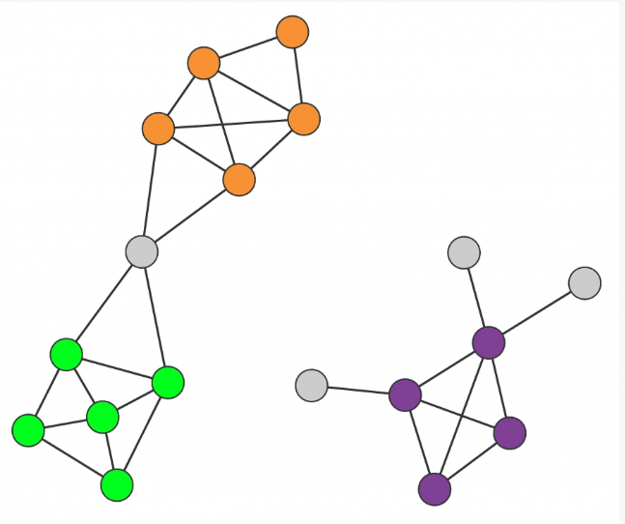
What are Communities?
Governed by Two Hypotheses:
Connectedness Hypothesis:
Each community is a connected subgraph.
Each community is linked to one component of the graph.
Density Hypothesis:
Nodes within a community are more likely to connect to each other than any other nodes in the graph.

Slide 5
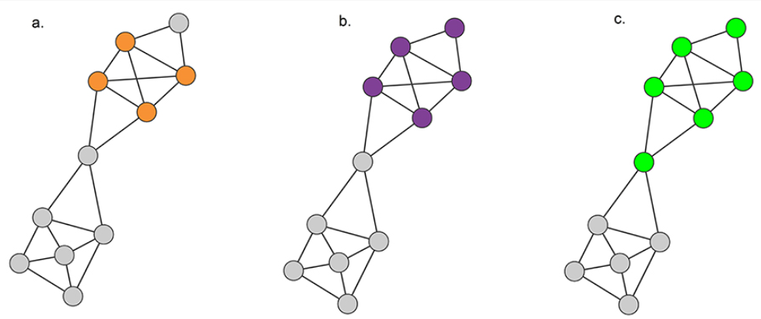
Three Possible Definitions of a Community
Cliques: Maximally connected subgraph
Every node in the community has a connection to every other node in the community.
Very strict definition.
Strong Community:
Every node within the community has more links to to other nodes within the community than any other node outside the community.
Weak Community:
There are more internal links within the community than links leaving the community.

Slide 6
What is Modularity?
Random Hypothesis: Randomly-wired networks lack an inherent community structure.
Randomly-generated graphs are expected to be uniform.
Allows us to compare subgraphs to ones that could be connected “by-chance”.
Measures the “value” of a particular graph partition.
Can be simply defined as:
Nc = # of communities partitioned in the graph
Lc = links in community c
Kc = total degree of the nodes in community c
Notes:
Modality basically measures the value of a community, which when added up over all the communities resembles the value of partitioning a graph into nc communities.

Slide 7
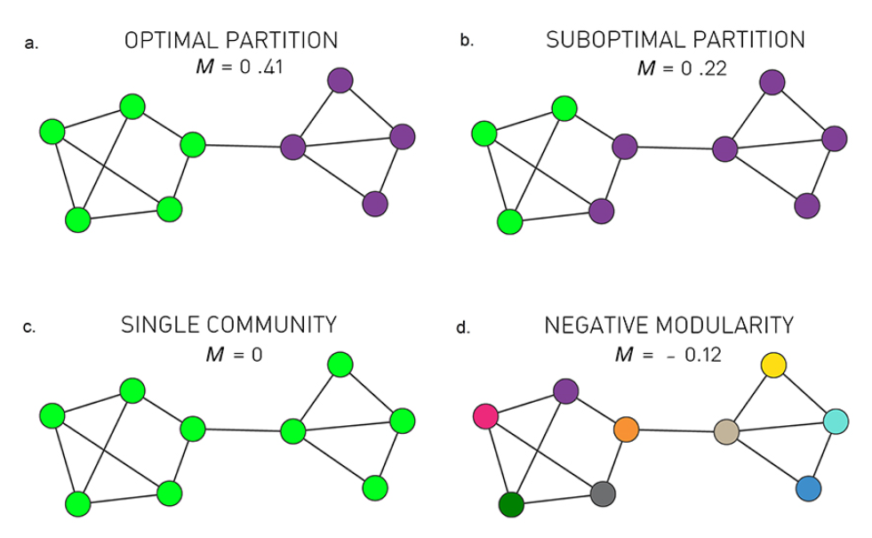
Meaning of Modularity
A positive modularity implies that communities are present, and the particular partition is a possible community structure.
M=0 implies that the entire network is a single community
A negative modularity implies that each separate node is its own community.
Algorithms that maximize modularity can predict the best partitioning.

Slide 8
Community Detection Problem
What is the best way to partition a graph into communities that achieve the best modularity?

Slide 9
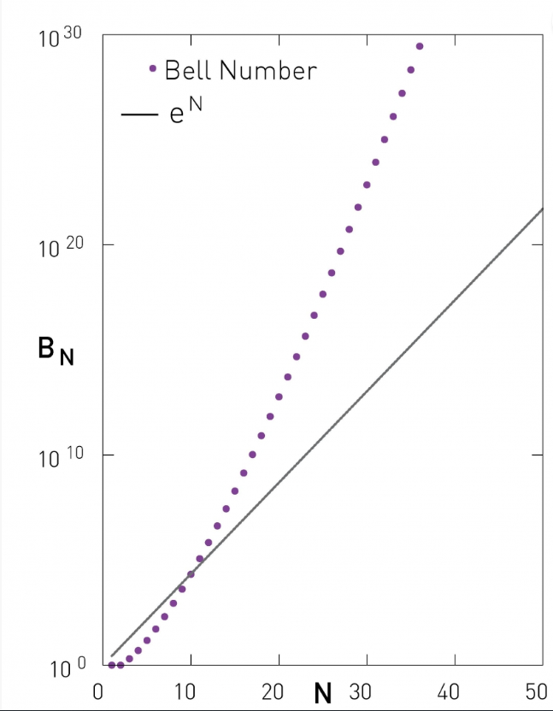
Brute-Force Algorithm
Generate all partitions possible.
Accept the partition with the highest modularity.
Problem: The number of partitions that can be generated increase exponentially with the number of nodes in a graph.

Slide 10
Community Detection is an NP-Hard Problem!

Slide 11
Greedy Algorithm Approach
Assign all nodes to their own community.
Inspect each community pair that is connected by at least one link. Merge the two communities into one link with the greatest change in modularity.
Repeat step 2 repeatedly until the graph has been partitioned into one community.
Return the partition with the greatest modularity.
Runtime: O(N^2).
Notes:
Log base 2

Slide 12
Outline of Presentation
Background Information
What are communities?
What is modularity?
Basic community detection algorithms.
Louvain Algorithm
Conclusion
Infomap Algorithm
Introduction To Paper
What is the problem?
Why do we care about having fast community detection algorithms?

Slide 13
Issues
The brute-force algorithm is very slow, especially for moderately large graphs.
Recall Bell’s Number
Unreasonable runtime for most networks.
Community Detection is an NP-Hard Problem.
Greedy Algorithm Approach approximates the best partition:
O(N^2) is going to be slow with very large, sparse networks (>1,000,000 nodes).

Slide 14
Two Fast Algorithms:
Louvain Algorithm
Infomap Algorithm

Slide 15
Two Fast Algorithms:
Louvain Algorithm
Infomap Algorithm

Slide 16
Louvain Algorithm
Step 1: Assign all nodes into their own community.
Step 2: For each node i in V, we examine their neighbors, computing the change in modularity that occurs if we add i to the community of each neighbor j:
Step 3: Have node i be in community j for the largest positive change in modularity. If there is no positive change in modularity, leave i in its current community.
Step 4: Repeat Steps 2-3 until no further actions can be taken (any move would result in a negative change in modularity).
Step 5: Generate a new graph, with the nodes being the communities and the edge weights between the total weights of the edges connecting each corresponding community.

Slide 17
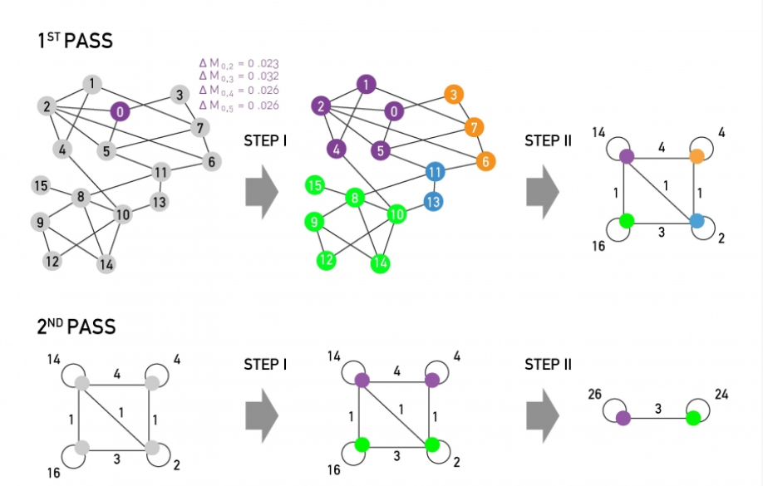
Example:

Slide 18
Louvain Algorithm Time Complexity
Runtime: O(L log(L)), or O(N log(N)) for sparse networks
Great runtime for larger networks.

Slide 19
Two Fast Algorithms:
Louvain Algorithm
Infomap Algorithm

Slide 20
Huffman Coding
Huffman Coding: Form of data compression to represent ordered elements in the least amount of bits possible.
Does this by assigning a code to each element on the list based on frequency, with the idea that the more frequently an element is repeated, the smaller its assigned code is.
Huffman Coding for Graphs:
A node is given a code, where the frequency is its degree.
We represent graph by a path, or a “random walker” traversing through the graph.
More information on Huffman Encoding https://www.youtube.com/watch?v=fPthQE7Li8M

Slide 21
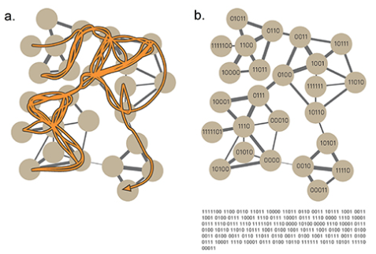
Example
Goal: Produce the smallest encoding of this random path.

Slide 22
Infomap Algorithm:
Consider a particular partition of a graph assorted into n communities:
Generate a code for each community in the partitioned graph.
Generate a code for each node within the community.
Generate a code to represent when we leave a community.
Minimum code length is determined by the map function:
First term: number of bits needed to represent paths between communities
q: the probability of a random walker switches communities in a given step
Second term: number of bits needed to represent paths within communities
pc: the probability of a random walker entering another node in the same community with each step.
H(Pc): The Huffman encoding length of the within-community movements, including the exit code.

Slide 23
Example:

Slide 24
Generating Partitions
So far, we have a function that produces the smallest encoding of a graph given a partition into separate communities.
How do we determine the partition?
Simply use another algorithm that will generate the partitions of communities.
Use the partitions generated by the Louvain Algorithm!
Now that we have our partitions and our Huffman code generation, we can now state our Infomap Algorithm.

Slide 25
Infomap Algorithm with Louvain Algorithm Partitioning
Goal: Minimize across all partitions!
Assign/code each node into its separate community.
For one node, look through its community, and make that community if it reduces L. Update L to the new value if so.
Continue to do this until there are no reductions available.

Slide 26
Example

Slide 27
Time Complexity
Will be the same as the runtime of the algorithm you use to partition the graphs.
The Infomap Algorithm that uses the Louvain Algorithm for generating the partition of the graphs:
O(L log L), or O(N log N) for sparse graphs.

Slide 28
Outline of Presentation
Background Information
What are communities?
What is modularity?
Basic community detection algorithms.
Louvain Algorithm
Conclusion
Infomap Algorithm
Introduction To Paper
What is the problem?
Why do we care about having fast community detection algorithms?

Slide 29
Accuracy / Speed
Both algorithms have the same level of accuracy as less efficient polynomial time community detection algorithms.
Both algorithms are relatively efficient, resulting in a faster community detection for very large networks.
Both algorithms optimize a function and use similar procedures
Louvain Algorithm: Maximizes Modularity.
Infomap Algorithm: Minimizes Map Equation.

Slide 30
Questions?

Slide 31
References
Barabási, A.-L. (n.d.). Advanced Topic 9.C Fast Algorithms for Community Detection. Network Science. Retrieved from http://networksciencebook.com/chapter/9#advanced-9c
Barabási, A.-L. (n.d.). Chapter 9: Communities. Network Science. Retrieved from http://networksciencebook.com/chapter/9
Huffman Coding. (2015). YouTube. Retrieved from https://www.youtube.com/watch?v=fPthQE7Li8M.

